Slide 1
Chat connect - A Real Time Chat And Communication App
T. DINESH NM id :
aut8121cs47 Reg.no: 812122104009

Slide 2
Introduction
Chat Connect could refer to a real-time chat and communication application designed to facilitate instant messaging, voice, and video communication between users. Here's an outline of what such an app could offer: - Real-Time Messaging -Voice and Video Calls - Presence and Status Indicators - End to End Encryption -Cross-Platform Compatibility -Customizable Notifications’ -User Profiles and Customization -File Sharing and Collaboration

Slide 3
Use Cases:
Personal Communication: Connecting with friends and family through texts, calls, and shared media. Business Collaboration: Teams can use ChatConnect for real-time communication, file sharing, and project management. Customer Support: Businesses could offer customer service via instant chat, voice, and video calls. Educational Use: Facilitating study groups, teacher-student communication, and class discussions in a secure platform.
Technologies:
To make an app like ChatConnect, the following technologies could be used:
Backend: Node.js, Python (Django, Flask), or Go for real-time processing.
Frontend: React Native or Flutter for cross-platform development.
WebRTC for real-time video and voice communication.

Slide 4
Main.Activity.kt
package com.project.pradyotprakash.flashchat import android.os.Bundle import androidx.activity.ComponentActivity import androidx.activity.compose.setContent import com.google.firebase.FirebaseApp class MainActivity : ComponentActivity() {
override fun onCreate(savedInstanceState: Bundle?) { super.onCreate(savedInstanceState) FirebaseApp.initializeApp(this)
setContent { NavComposeApp()
}
}
}

Slide 5
fun NavComposeApp() {
val navController = rememberNavController() val actions = remember(navController) { Action(navController) } FlashChatTheme {
NavHost(
navController = navController, startDestination = if (FirebaseAuth.getInstance().currentUser != null)
Home else
AuthenticationOption
) {
composable(AuthenticationOption) {

Slide 6
AuthenticationView(
register = actions.register, login = actions.login
)
}
c o m p o s a b Rl eegist(erVRiewe( g i
s t heomr e )= act{ions.home, back
= actions.navigateBack
)
}
c o m p o s
a LboglinVeiew( ( L o
g i hnom) e = a{ ctions.home, back
= actions.navigateBack
)
}

Slide 7
composable(Home) {
HomeView()
}
}
}
}
class LoginViewModel : ViewModel() {
private val auth: FirebaseAuth = Firebase.auth
private val _email = MutableLiveData("") val email: LiveData<String> = _email
private val _password = MutableLiveData("") val password: LiveData<String> = _password

Slide 8
private val _loading = MutableLiveData(false) val loading: LiveData<Boolean> = _loading
// Update email
fun updateEmail(newEmail: String) {
_email.value = newEmail
}
// Update password
fun updatePassword(newPassword: String) {
_password.value = newPassword
}
// Register user
fun loginUser(home: () -> Unit) {
if (_loading.value == false) {

Slide 9
val email: String = _email.value ?: throw IllegalArgumentException("email expected") val password: String =
_password.value ?: throw IllegalArgumentException("password expected")
_loading.value = true auth.signInWithEmailAndPassword(email, password)
.addOnCompleteListener {
if (it.isSuccessful) { home()
}
_ | l | o | a | d | i | n
}}}}g | . | v | a | l | u | e
= |  | f | a | l | s | e

Slide 10
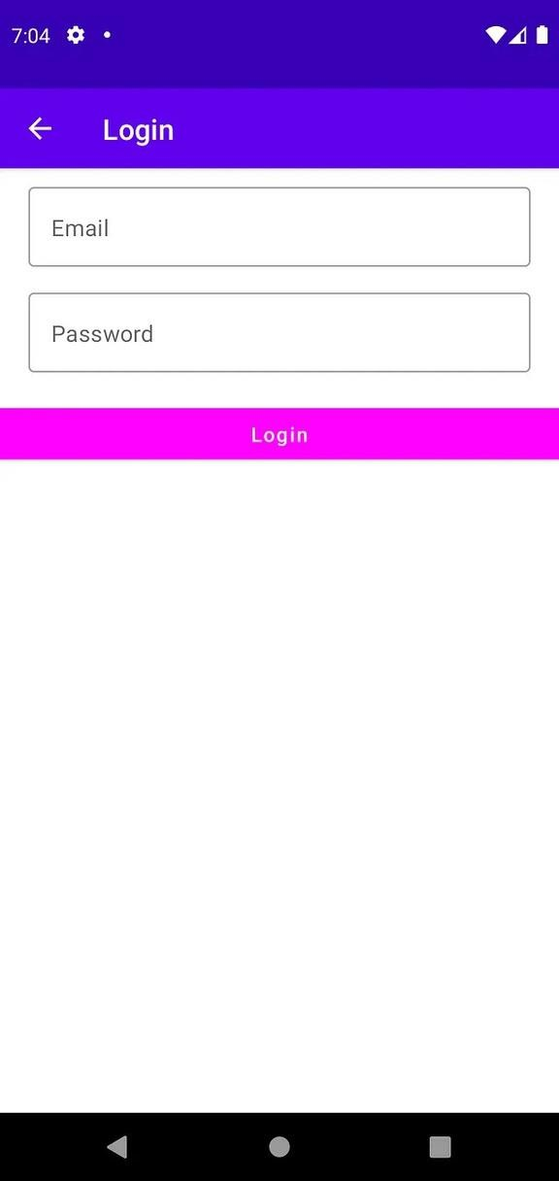

Slide 11
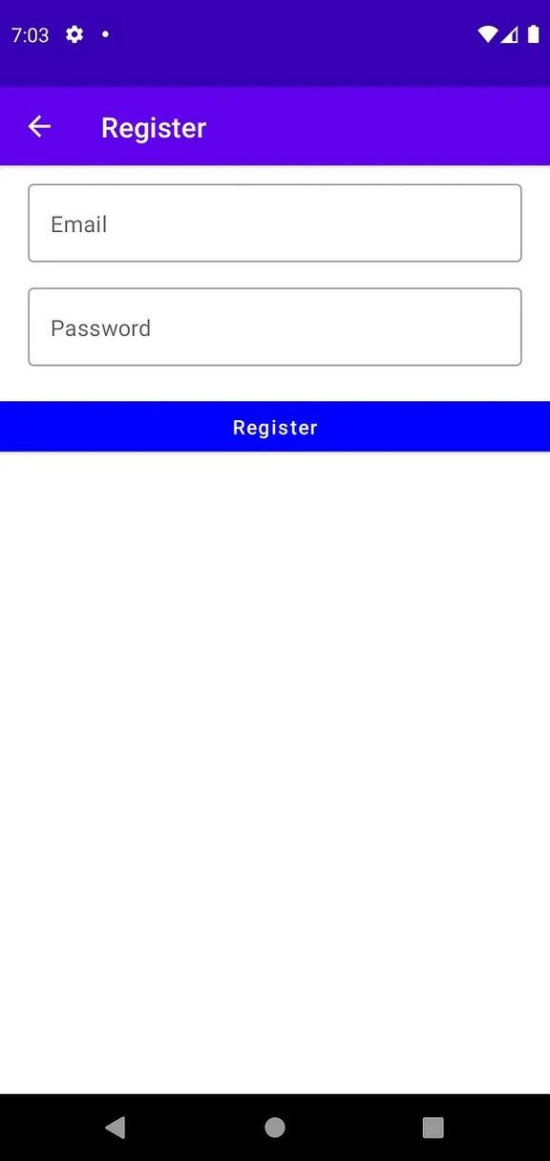

Slide 12
